Slide 1
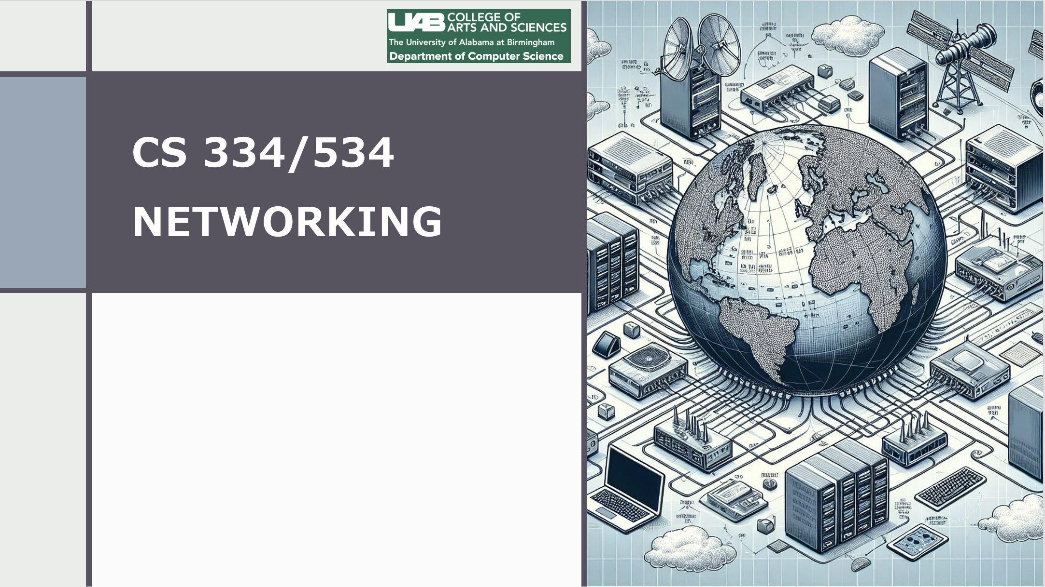
Dr. Ragib Hasan
Lecture 5.4:
IP Address assignment, DHCP

Slide 2
How are IP addresses assigned
There are multiple stages
  ISP gets a chunk of IP address range
  The chunk of addresses within an ISP is broken into multiple subnets
  A host joining a subnet either gets the IP address statically assigned (needs hard coded IP address allocation), OR is dynamically assigned an IP address via the DHCP protocol.

Slide 3
DHCP: Dynamic Host Configuration Protocol
If you connected to the WiFi network in this room, your phone or laptop has used DHCP to be assigned an IP address
DHCP overview:
  host broadcasts DHCP discover msg [optional]
  DHCP server responds with DHCP offer msg [optional]
  host requests IP address: DHCP request msg
  DHCP server sends address: DHCP ack msg

Slide 4
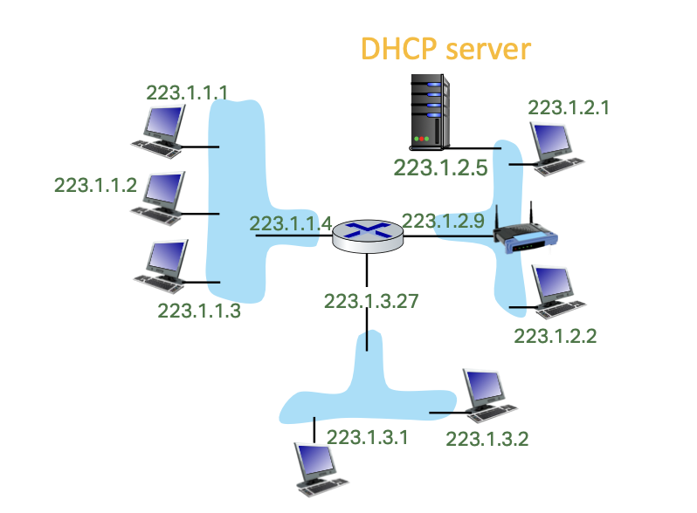
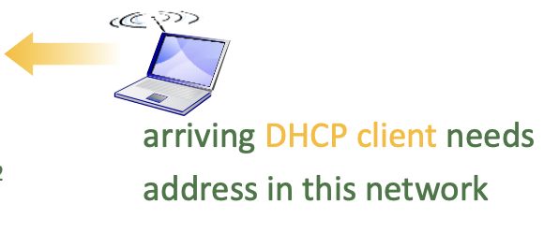
DHCP Example
A DHCP Server is included in each network to deal with IP address allocation
Usually, it’s collocated with the access point or router

Slide 5
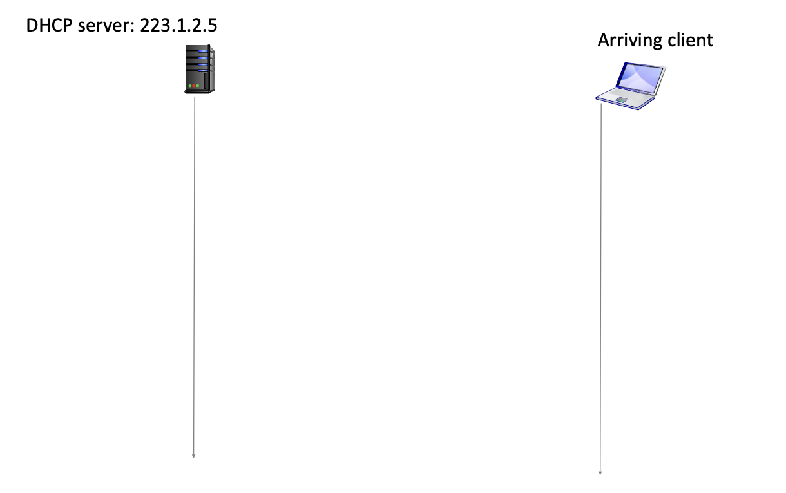
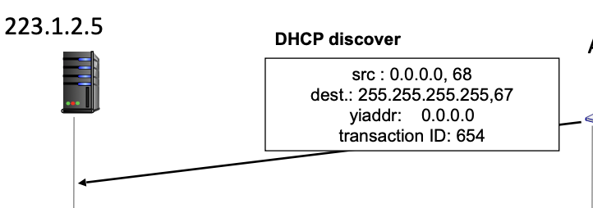
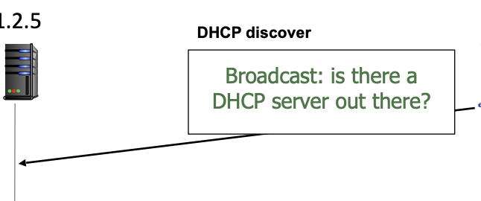
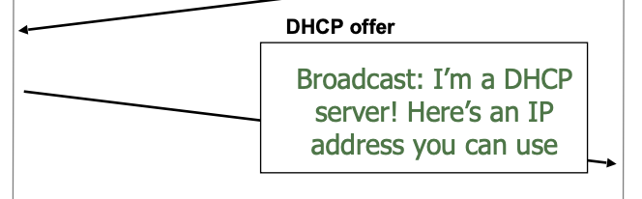
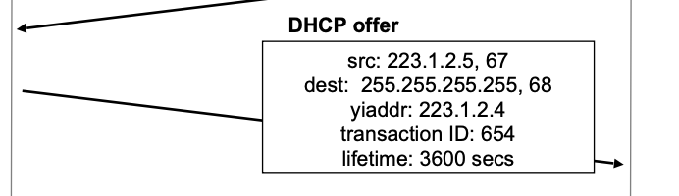
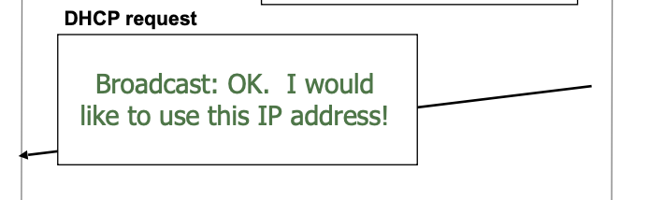
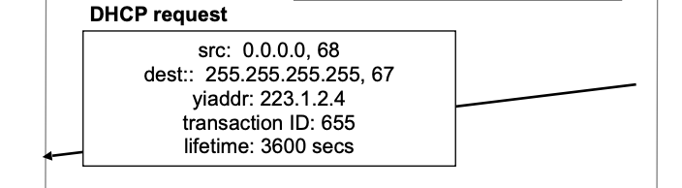
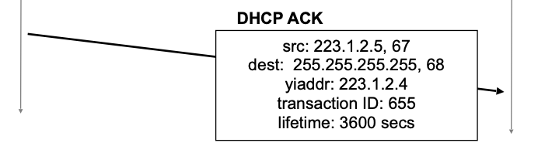
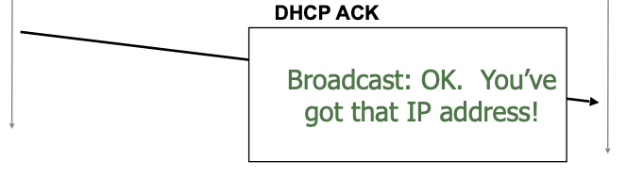
DHCP

Slide 6
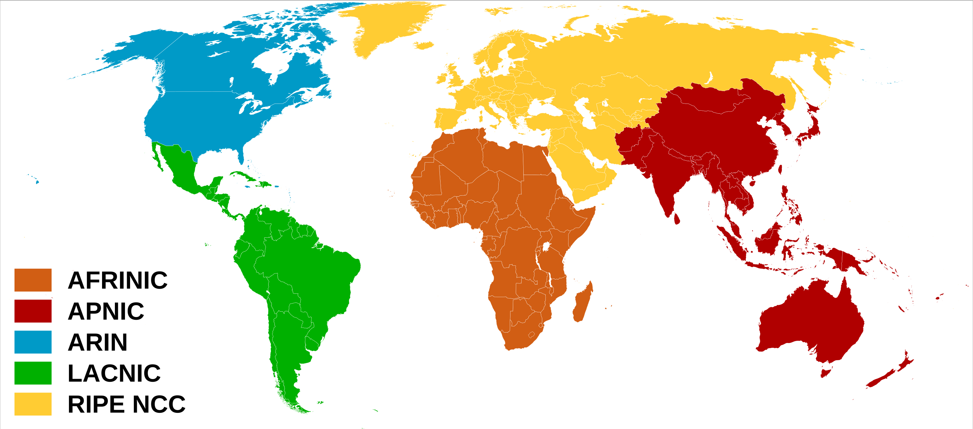
How are IP addresses assigned
How does a network or ISP get its IP address block?
  An organization named ICANN: Internet Corporation for Assigned Names and Numbers (http://www.icann.org/) manages the global IP address ranges
  Internet Assigned Numbers Authority (IANA) within ICANN allocates IP address ranges to 5 regional registries
    ARIN: North America
    APNIC: Asia Pacific
    RIPE NCC: Europe
    LACNIC: Latin America
    AFRINIC: Africa
  ICANN also manages DNS root zone, including delegation of individual Top Level Domain (.com, .edu , …) management etc.

Slide 7
Are we out of IP addresses?
As of 2017, four out of five (APNIC, RIPE, LACNIC, ARIN) of the Regional Internet Registries (RIRs) have run out of freely available IPv4 address space.
Some companies got allocated huge IP address blocks (e.g., class A /8 networks)
  Apple owns 17.0.0.0/8
  Mercedez owns 53.0.0.0/8
  MIT has 18.0.0.0/8
How did they get such a large range?

